Slide 1
Logistic Growth Graph of Potential Bubonic Outbreak VS COVID-19 in Denver, CO
Deisy Vega Lujan
Lulu Abuaba
Santiago Perez

Slide 2


Our Goal
We want to understand the differences in speed of spread, total infections, and deaths between these diseases, and to highlight how crucial early intervention is in these situations.
Question: How might a bubonic plague outbreak in Denver compare to that of the COVID-19 outbreak?

Slide 3


How?
We used the SIR (Susceptible-Infected-Recovered) differential equation model on Denver’s population, as well as CDC-based parameters, to compare the spread of two diseases in Denver- the Bubonic Plague and COVID-19
The model allows us to calculate peak infections, time of peak, total infections, deaths, and fatality rate.

Slide 4
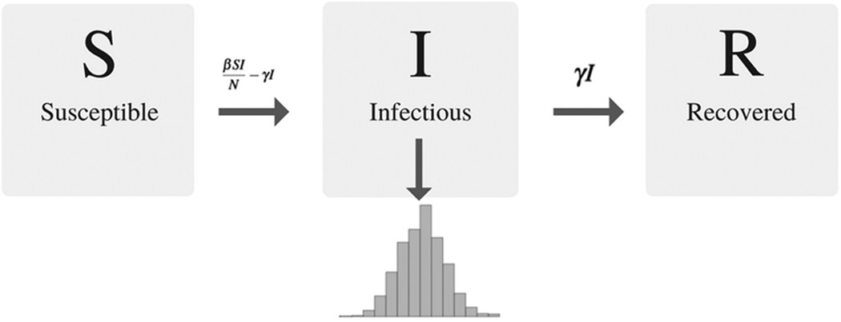
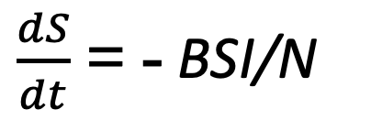
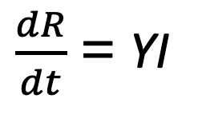
SIR Model Differential Equations
$\frac{dS}{dt}$ = - ΒSI/N
$\frac{dI}{dt}$ = ΒSI/N-YI → climax of infection when =0 (new infections=recoveries)
$\frac{dR}{dt}$ = YI
S: Number of susceptible individuals (those who can catch the disease)
I: Number of infectious individuals (those who can spread the disease)
R: Number of recovered individuals (no longer infectious, often immune)
Β (beta): Transmission rate, representing the probability an infectious person infects a susceptible person per unit time
Y (gamma): Recovery rate, representing the fraction of infectious individuals who recover (or are removed) per unit time
t: Time

Slide 5

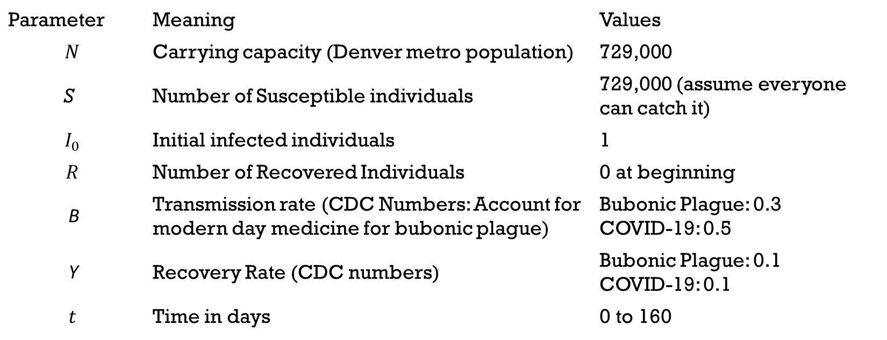
Parameters
Parameter | Meaning | Values
$$N$$ | Carrying capacity (Denver metro population) | 729,000
S | Number of Susceptible individuals | 729,000 (assume everyone can catch it)
$$I_{0}$$ | Initial infected individuals | 1
$$R$$ | Number of Recovered Individuals | 0 at beginning
Β | Transmission rate (CDC Numbers: Account for modern day medicine for bubonic plague) | Bubonic Plague: 0.3 COVID-19: 0.5
Y | Recovery Rate (CDC numbers) | Bubonic Plague: 0.1 COVID-19: 0.1
$$t$$ | Time in days | 0 to 160

Slide 6

Possible Limitations
Model assumes a closed population
The model doesn’t account for births, migration, or deaths by other causes
Parameters Beta (B) and Gamma (Y) are kept constant
This implies no behavioral changes, no vaccinations, and no public health interventions
This is unrealistic, but when determining how the diseases might spread when left unchecked, these parameters lead to more accurate results when they remain fixed.

Slide 7
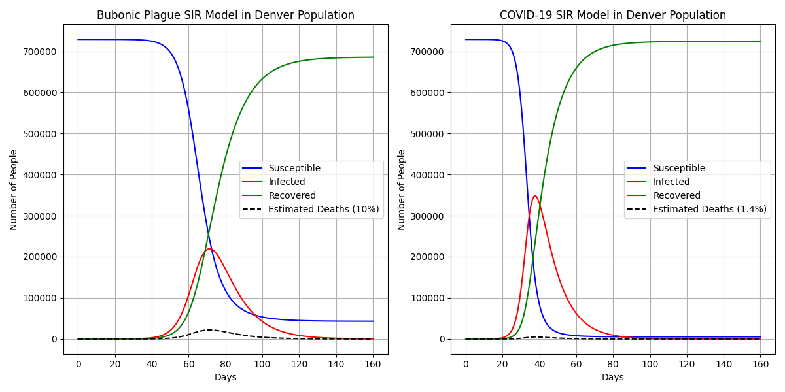
Graph

Slide 8

Results
Bubonic Plague Final Results:
Total Infected: 685878
Total Deaths (10% fatality): 68588
Peak Infection Day: 71
Peak Infected: 219627
Deaths at Peak: 21963
COVID-19 Final Results:
Total Infected: 723945
Total Deaths (1.4% fatality): 10135
Peak Infection Day: 37
Peak Infected: 348081
Deaths at Peak: 4873

Slide 9

Conclusions
While COVID-19 infected more people overall, the Bubonic Plague was much more deadly
Bubonic Plague: 685,878 infected, 68,588 deaths, making for a 10% fatality rate
COVID-19: 723,945 infected, 10,135 deaths, making for a 1.4% fatality rate
COVID-19 peaks earlier, 37 days in, meaning that it has a faster initial spread than the Bubonic Plague
However, the plagues high mortality rate means it remains extremely dangerous- it is still crucial to catch this outbreak early, despite its later peak at 71 days
At their peaks, the Bubonic Plague had caused 21,963 deaths, while COVID-19 had 4,873 deaths.

